Slide 1
Rehabilomics: Advancing SCI Rehabilitation through Omics
SPF Colloquium Talk on July 8th
Alexander Stacul, PhD student
July 8th 2025

Slide 2
Rehabilomics: Advancing SCI Rehabilitation through Omics
SPF Colloquium Talk on July 8th
Alexander Stacul, PhD student
July 8th 2025

Slide 3
Rehabilomics: Advancing SCI Rehabilitation through Omics
SPF Colloquium Talk on July 8th
Alexander Stacul, PhD student
July 8th 2025

Slide 4
Outline
Rehabilomics
Transcriptomics
Metagenomics (Microbiome sciences)
Proteomics
Genomics / Epigenomics / Metabolomics
Literature review
PhD Project
Digitalization of the Biobank
Future outcome

Slide 5
Rehabilomics
Introduction
Rehabilitation
… "a set of interventions designed to optimize functioning and reduce disability in individuals with health conditions in interaction with their environment“ ¹
Omics
… “any of several areas of biological study defined by the investigation of the entire complement of a specific type of biomolecule or the totality of a molecular process within an organism.” ²
Notes:
[1] https://www.who.int/news-room/fact-sheets/detail/rehabilitation
[2] https://www.britannica.com/science/omics

Slide 6
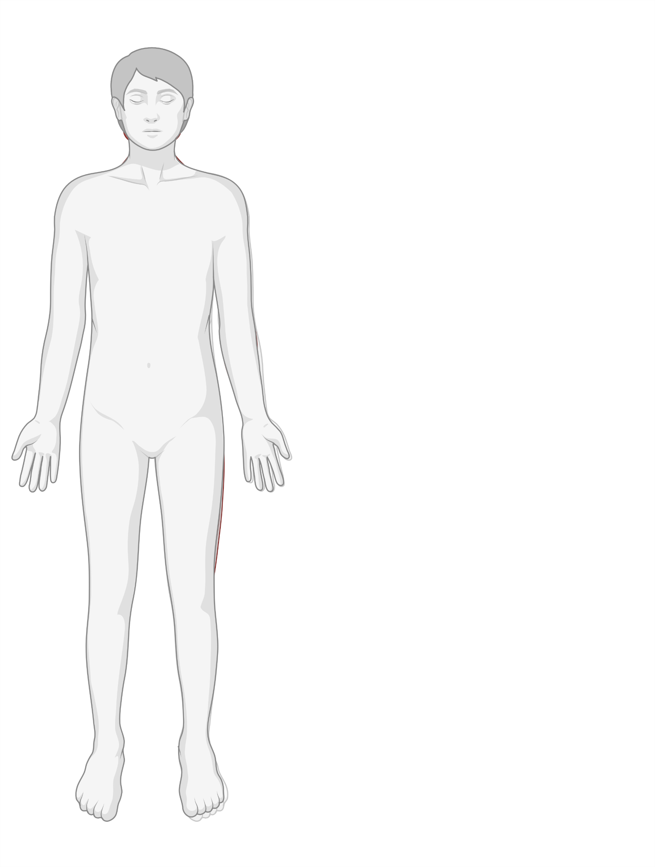
Rehabilomics
Relevance
SCI can lead to:
Temporal or permanent disruption of sensory, motor and autonomic functions
Effectiveness of rehabilitation based on individual level

Slide 7
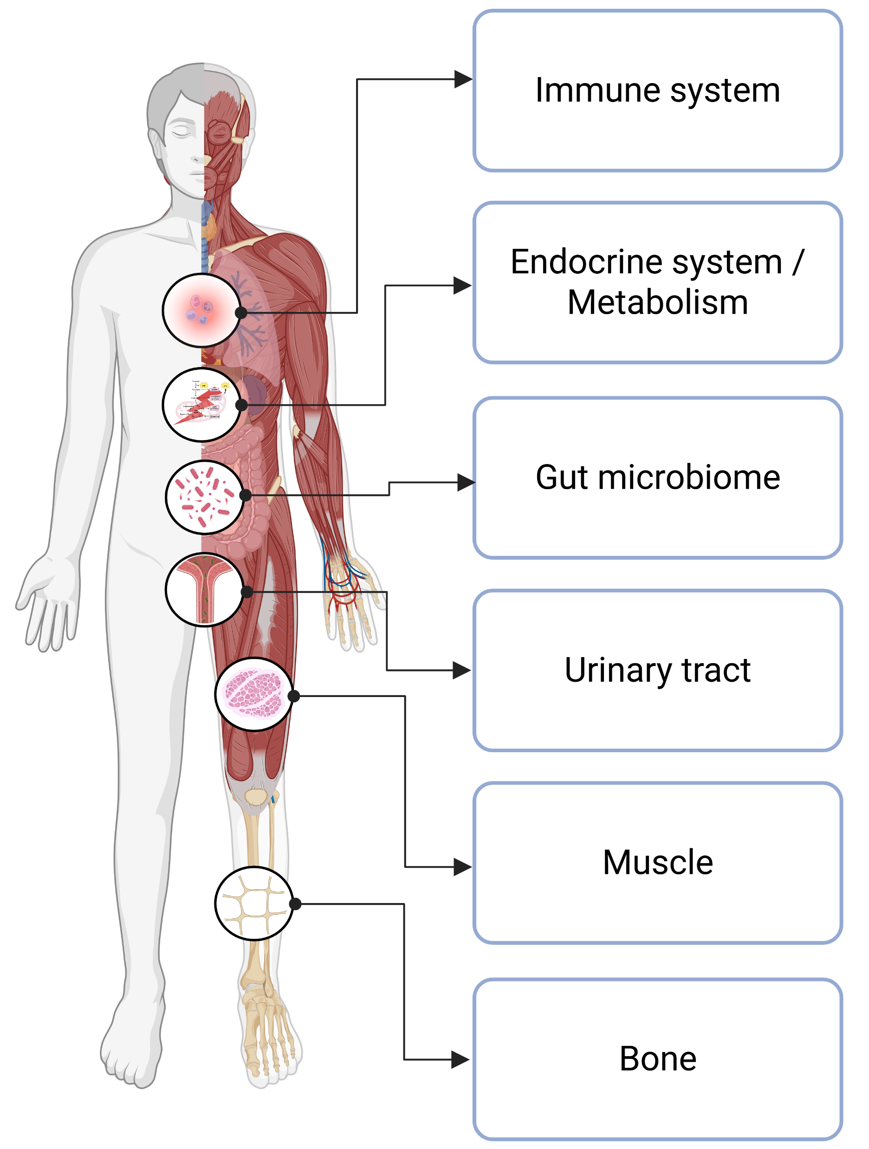
Rehabilomics
Relevance
SCI can lead to:
Temporal or permanent disruption of sensory, motor and autonomic functions
Effectiveness of rehabilitation based on individual level
Rehabilitation often improves physiological processes, but do not reflect in clinically measured outcomes
Understanding molecular dynamics crucial for addressing diversity after SCI

Slide 8
Rehabilomics
Transcriptomics ³
looks at RNA
🧬 listening in on which instructions (genes) the body is using at a specific moment
💡 Why it's useful in rehab:
Activation or suppression of genes
Helps track recovery processes
Notes:
which is what our body uses to read genes and make proteins.
, like nerve repair or inflammation.

Slide 9
Rehabilomics
Metagenomics⁴
studies the microbes living in and on our body
🦠 Affect inflammation, brain function, and immune health
💡 Why it's useful in rehab:
See how gut microbes change
Discover links between gut health and recovery
Notes:
all important in recovery.

Slide 10
Rehabilomics
Proteomics ⁵
studies proteins, which are the working molecules of the body.
🛠️ Proteins carry out almost everything: movement, repair, signals, defense.
💡 Why it's useful in rehab:
After injury or during rehab, protein levels shift
Tracking these changes tells us if recovery is progressing
Find biomarkers
Notes:
to predict how someone will respond to treatment.

Slide 11
Rehabilomics
Genomics⁶ / Epigenomics⁷ / Metabolomics⁸
Metabolomics 🍎 Looks at metabolites
💡 Tells us about the body’s real-time condition
Genomics 🧬 Looks at the full DNA sequence
💡 Helps predict how someone might respond to rehab based on their genetics
Epigenomics 🔐 Looks at how genes are turned on/off by the environment
💡 Important for understanding how injury, stress, or rehab can cause lasting changes.
Notes:
Metabolomics: small molecules from digestion, energy, or stress (like sugar, lactate, or hormones). —energy use, stress, inflammation.
Genomics:
Epigenomics: —without changing the DNA itself.

Slide 12
Literature review
Precision Rehabilitation through Omics: Systematic Review of Molecular Monitoring and Intervention Strategies in Spinal Cord Injury
Objectives:
Give a comprehensive overview of omics technologies used
Effectiveness of different interventions in SCI rehabilitation
Methodology:
Following 24 steps by Muka et al.⁹
Three databases were searched (Embase, Medline [Ovid], Web of Science)
Screening, data extraction and risk of bias assessment (National Heart Lung and Blood Institute Quality Assessment Tool) were done independently by two reviewers

Slide 13
Literature review
Results
6021 Potentially relevant citations identified
2041 Embase
2053 Medline via Ovid
1927 Web of Science
Identification
1810 duplicates removed
4211 citations were evaluated based on titles and abstract
Screening
136 Full-text articles retrieved for a detailed evaluation
Eligibility
112 articles were EXCLUDED due to:
4 Inappropriate outcome
74 Inappropriate design
20 Inappropriate population
1 Duplicates
6 Reviews and abstracts
6 Records not retrieved
1 Retraction
23 studies included
Exercise and electric stimulation (15)
Diet (3)
Medications, hormones and cell therapies (5)
Included

Slide 14



Literature review
Results
6021 Potentially relevant citations identified
2041 Embase
2053 Medline via Ovid
1927 Web of Science
Identification
1810 duplicates removed
4211 citations were evaluated based on titles and abstract
Screening
136 Full-text articles retrieved for a detailed evaluation
Eligibility
112 articles were EXCLUDED due to:
4 Inappropriate outcome
74 Inappropriate design
20 Inappropriate population
1 Duplicates
6 Reviews and abstracts
6 Records not retrieved
1 Retraction
23 studies included
Exercise and electric stimulation (15)
Diet (3)
Medications, hormones and cell therapies (5)
Included
8 RCTs
5 non-RCTs
10 pre-post trials

Slide 15
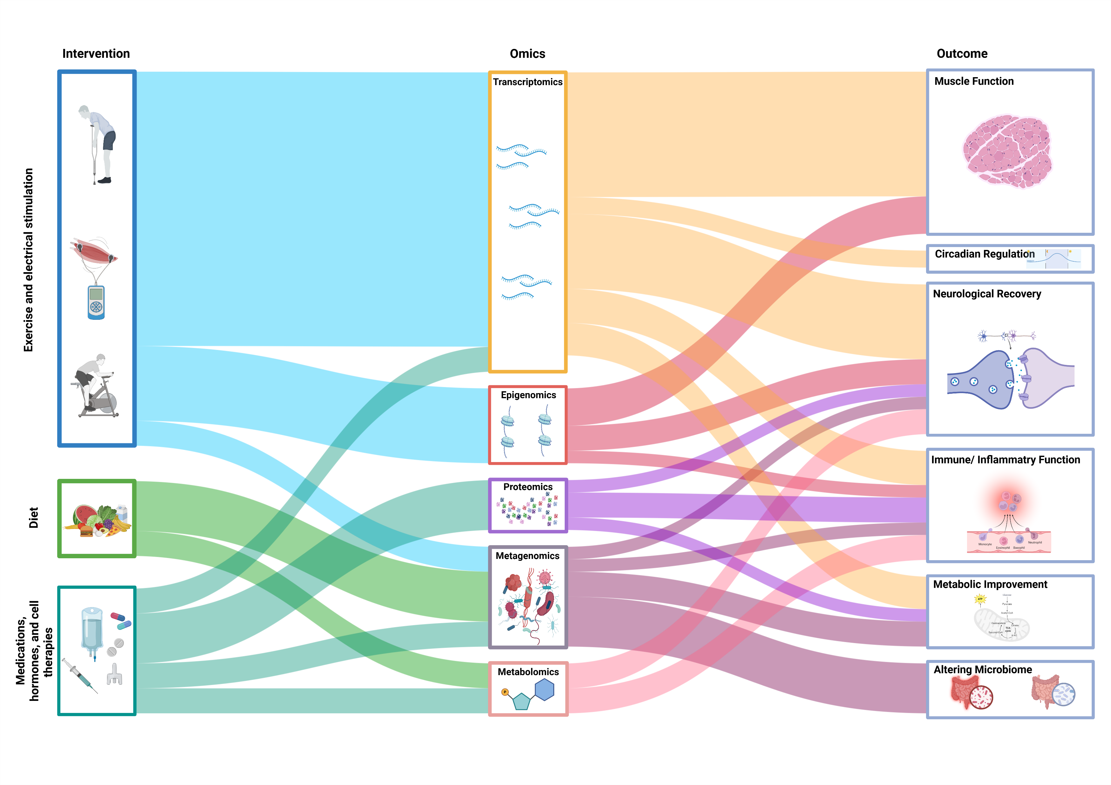
Literature review
Results

Slide 16
48%
65%
4%
9%
13%
17%
22%
9%

Slide 17
PhD Project
Digitalization of the SwiSCI Biobank - Relevance
Centralized Data Integration
Longitudinal
Improved Quality
Personalized
Interoperability and Data
(AI and Predictive Modelling)
FAIR

Slide 18

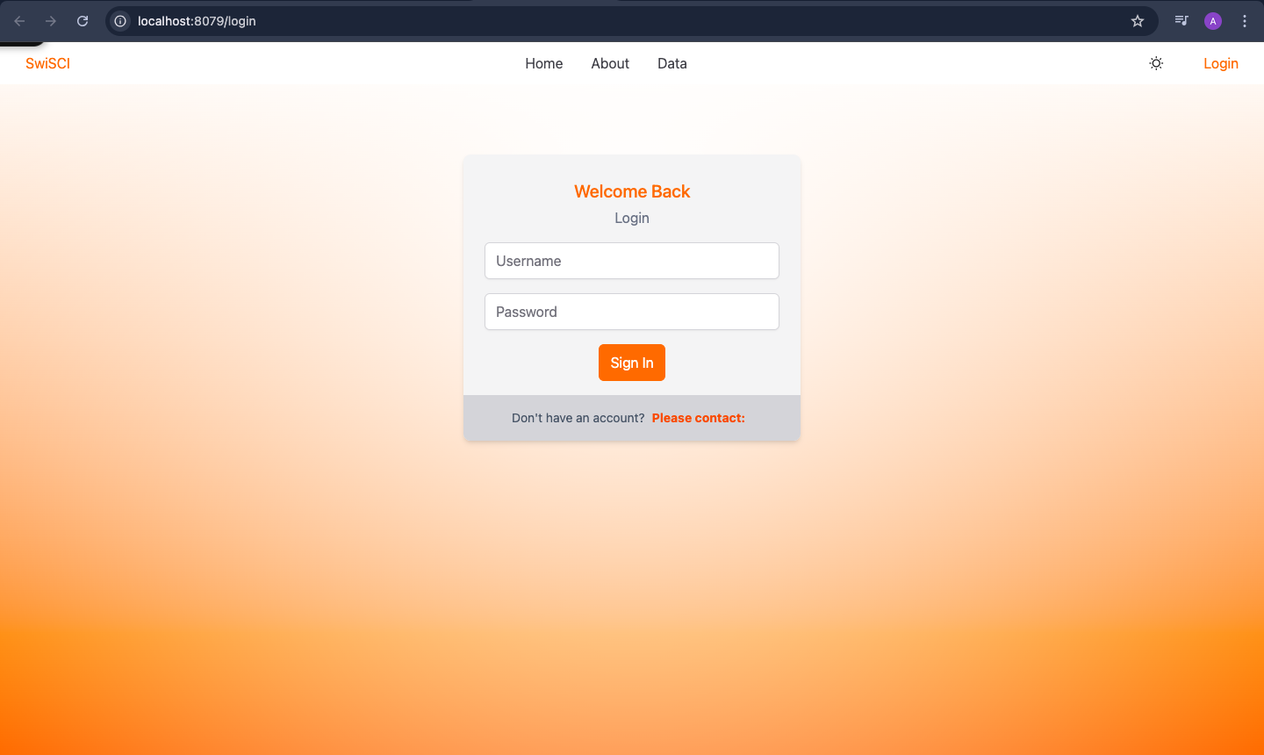
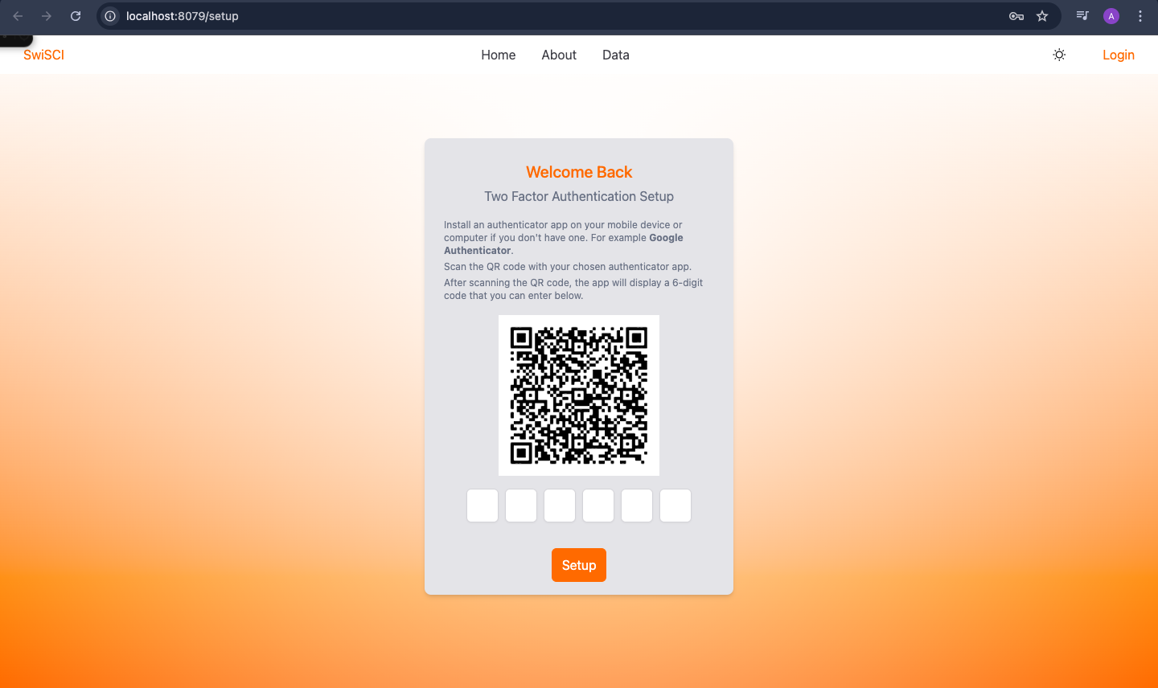
PhD Project
Digitalization of the SwiSCI Biobank - Security

Slide 19
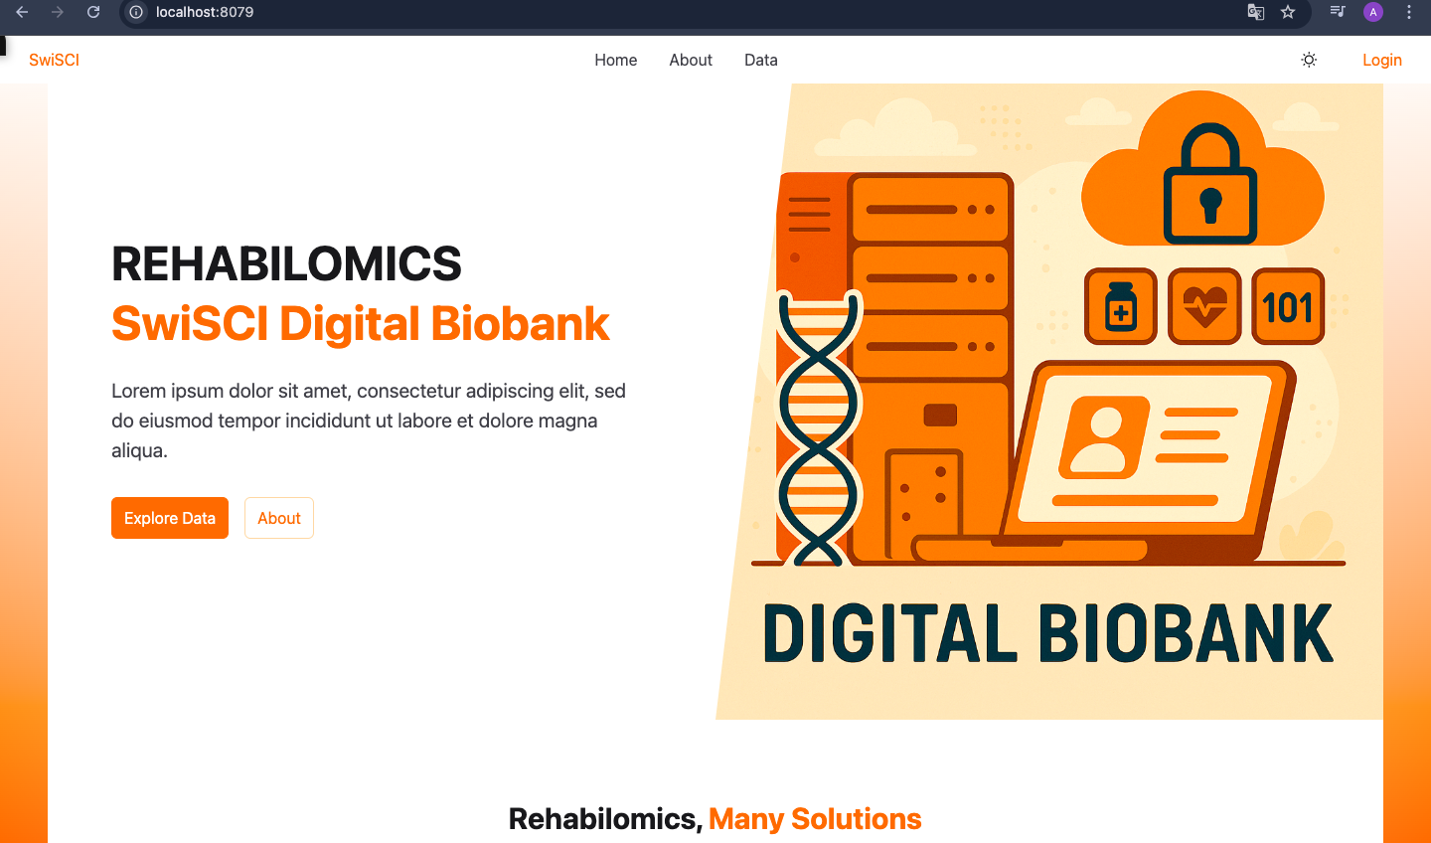
PhD Project
Digitalization of the SwiSCI Biobank - Home

Slide 20
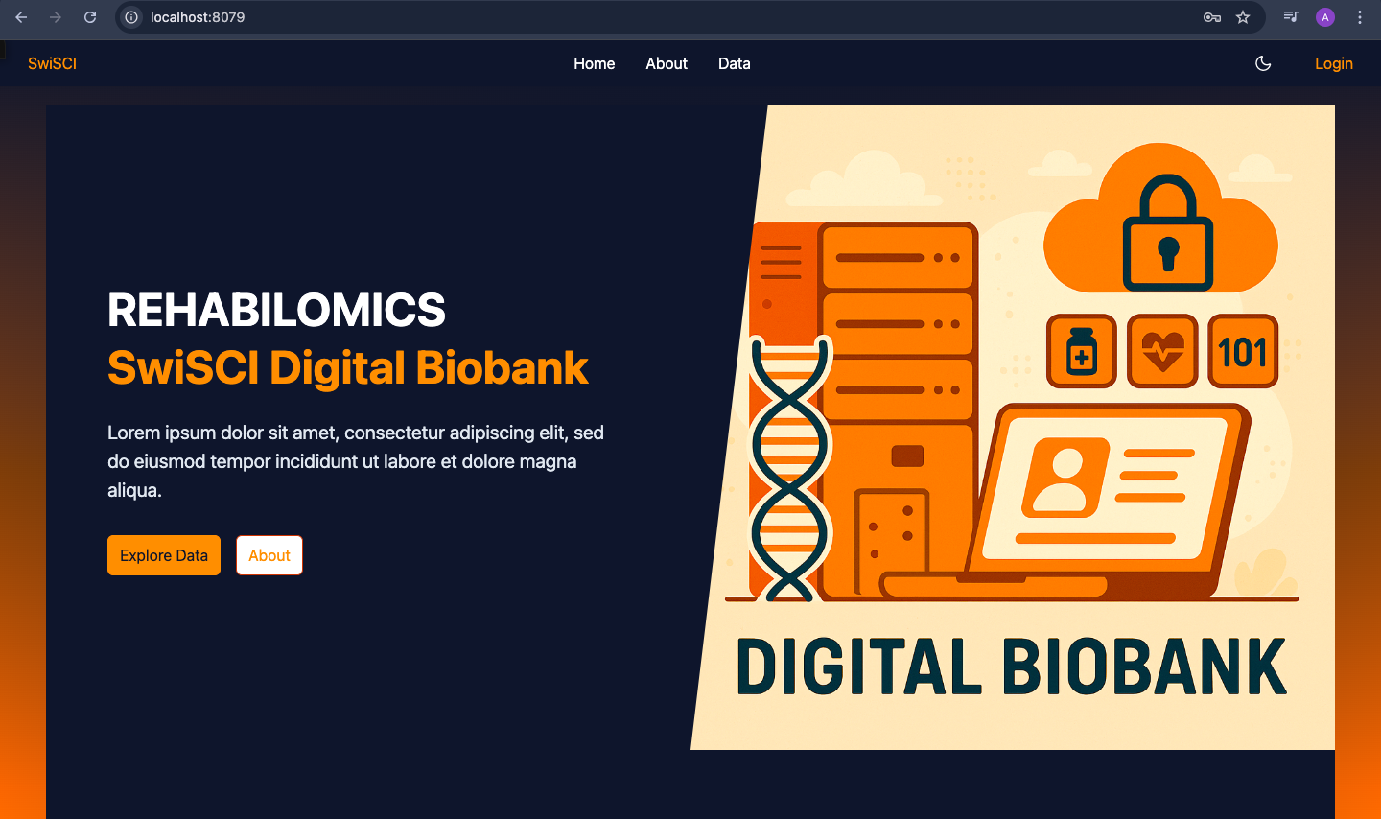
PhD Project
Digitalization of the SwiSCI Biobank - Home

Slide 21
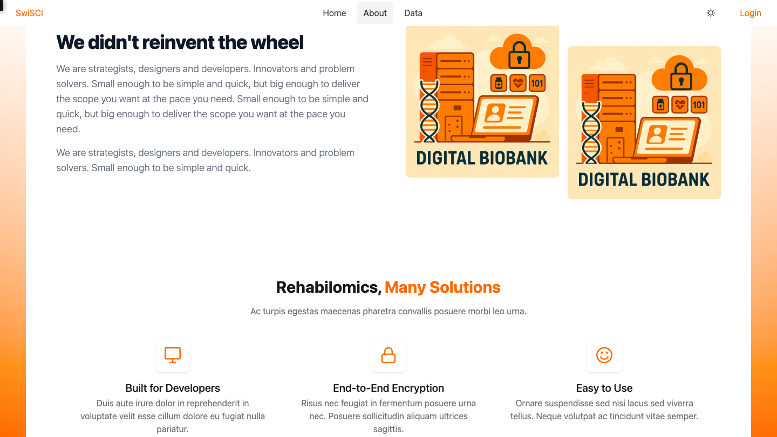
PhD Project
Digitalization of the SwiSCI Biobank - About

Slide 22
PhD Project
Digitalization of the SwiSCI Biobank - Data

Slide 23
Future Outcome
Objective: Identification of molecular signatures, and linking them to clinical outcomes
Aim 1: Comprehensive Analysis and Analytical Framework Development
Aim 2: Development of the Human SCI Rehabilomics Atlas
Aim 3: Development of Rehabilomics Maelstrom Catalogue

Slide 25
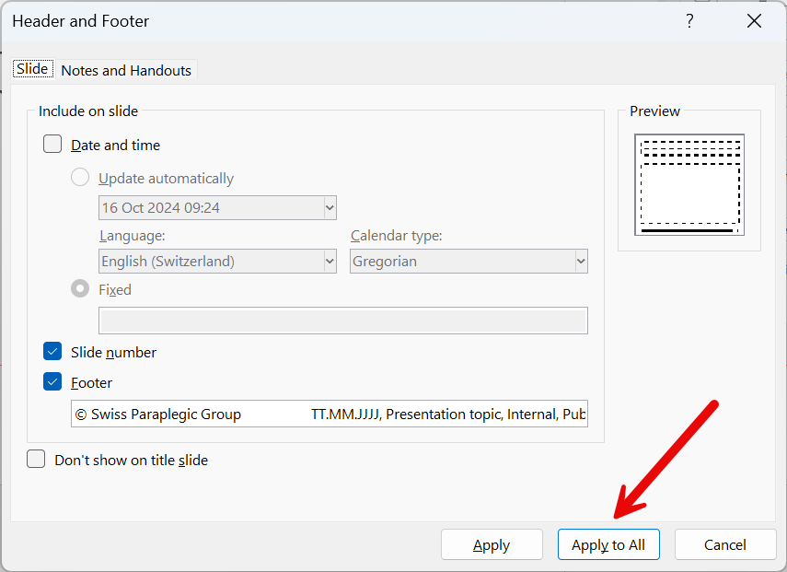
Tip: Easily customize footer anywhere
Subtitle on one line
PowerPoint offers a very simple option for changing the footer (see this slide as an example).
Click on the tab “Insert” and then “Header and footer”.
You can now adjust the footer by pressing “Apply to all”.

Slide 26






Title on one line
Subtitle on one line
Heading
Paragraph This is only a dummy text, It will be overwritten with the current presentation text. Aperuptatet vel ipit aperchit, iusanduci dis eosa sus essuntorum doluptatio.
Heading
Paragraph This is only a dummy text, It will be overwritten with the current presentation text.
Heading
Paragraph This is only a dummy text, It will be overwritten with the current presentation text. Aperuptatet vel ipit aperchit, iusanduci dis eosa sus essuntorum doluptatio.
Heading
Paragraph This is only a dummy text, It will be overwritten with the current presentation text.
Heading
Paragraph This is only a dummy text, It will be overwritten with the current presentation text. Aperuptatet vel ipit aperchit, iusanduci dis eosa sus essuntorum doluptatio.
Heading
Paragraph This is only a dummy text, It will be overwritten with the current presentation text.

Slide 27
Process diagram – variant 1
Subtitle on one line
Phase 1
Phase 1
Phase 1
Phase 1
Heading
Paragraph This is only a dummy text, it will be overwritten with the current presentation text.
Heading
Paragraph This is only a dummy text, it will be overwritten with the current presentation text.
Heading
Paragraph This is only a dummy text, it will be overwritten with the current presentation text.
Heading
Paragraph This is only a dummy text, it will be overwritten with the current presentation text.

Slide 28
Process diagram – variant 2
Subtitle on one line
Phase 1
Paragraph This is only a dummy text, It will be overwritten with the current presentation text. Aperuptatet vel ipit aperchit, iusanduci dis eosa sus essuntorum doluptatio.
Phase 1
Phase 1
Paragraph This is only a dummy text, It will be overwritten with the current presentation text. Aperuptatet vel ipit aperchit, iusanduci dis eosa sus essuntorum doluptatio.
Phase 1
Paragraph This is only a dummy text, It will be overwritten with the current presentation text. Aperuptatet vel ipit aperchit, iusanduci dis eosa sus essuntorum doluptatio.
Phase 1
Paragraph This is only a dummy text, It will be overwritten with the current presentation text. Aperuptatet vel ipit aperchit, iusanduci dis eosa sus essuntorum doluptatio.

Slide 29
Title on one line
Subtitle on one line
Heading
Paragraph This is only a dummy text, It will be overwritten with the current presentation text.
Heading
Paragraph This is only a dummy text, It will be overwritten with the current presentation text.
Heading
Paragraph This is only a dummy text, It will be overwritten with the current presentation text.
Heading
Paragraph This is only a dummy text, It will be overwritten with the current presentation text.
Week 20
Week 21
Week 22
Week 23
Week 24
Week 25
Week 26
Heading
Paragraph This is only a dummy text, It will be overwritten with the current presentation text.
Heading
Paragraph This is only a dummy text, It will be overwritten with the current presentation text.
Heading
Paragraph This is only a dummy text, It will be overwritten with the current presentation text.

Slide 31
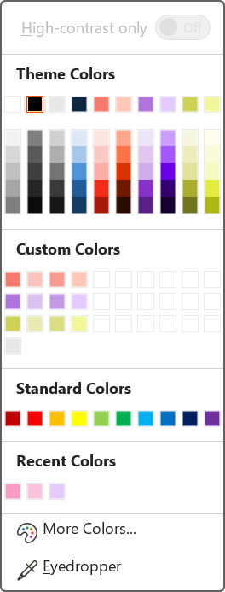

Colour sequence diagrams
Intermediate levels can be assigned manually
Colour grading for graphics with seven or more colours – intermediate levels can be found under “User-defined colours”
Colour grading for graphics with six or more colours – these colours will be assigned automatically

Slide 32



















































Overview of icons

